Slide 1
Lab 05
Investigation of Open-Drain Gate Characteristics
Source: Purdue ECE270

Slide 2
INSTRUCTIONAL OBJECTIVES:
To better understand open-drain gate static and dynamic behavior
To effectively choose the proper value of pull-up resistor for an open-drain circuit
2

Slide 3
EXPERIMENT DESCRIPTION
So-called “open-drain” gates − like the quad 2-input open-drain NAND chip (74HC03) − differ from “regular” gates in that they only contain N-channel (“pull down”) transistors.
Recall that a normal CMOS gate uses a P-channel MOSFET as an “active pull-up” to source current in the high state.
An open-drain gate, having no such P-channel device, has to rely on an external pull-up resistor (“passive pull-up”) to produce a logic high voltage.
In this experiment you will investigate the characteristics of open-drain gates and practice utilizing information provided in a device data sheet.
In particular, you will examine the tradeoffs between use of the “minimum” and “maximum” values of pull-up resistors allowable

Slide 4
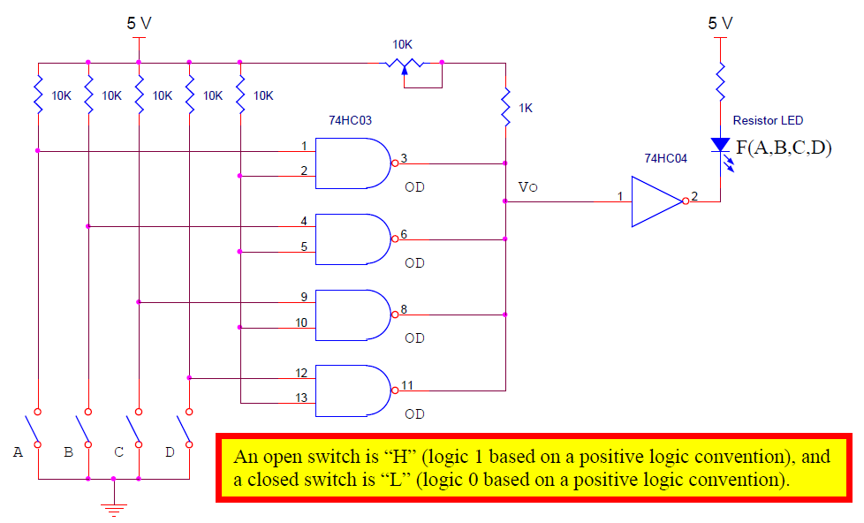
STEP (1): CIRCUIT CONSTRUCTION AND VERIFICATION
Construct the circuit illustrated below and set the potentiometer approximately mid-position.
Complete the truth table by entering “H” for combinations that cause the LED to illuminate and “L” for those that do not. Determine the logic function realized.

Slide 5
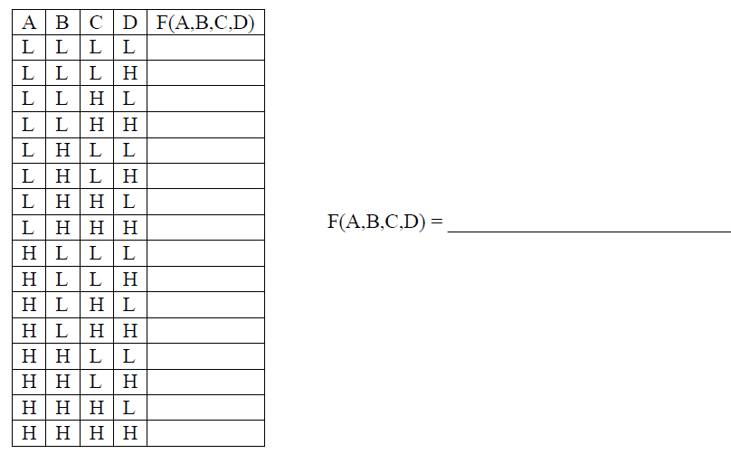
STEP (1): CIRCUIT CONSTRUCTION AND VERIFICATION

Slide 6
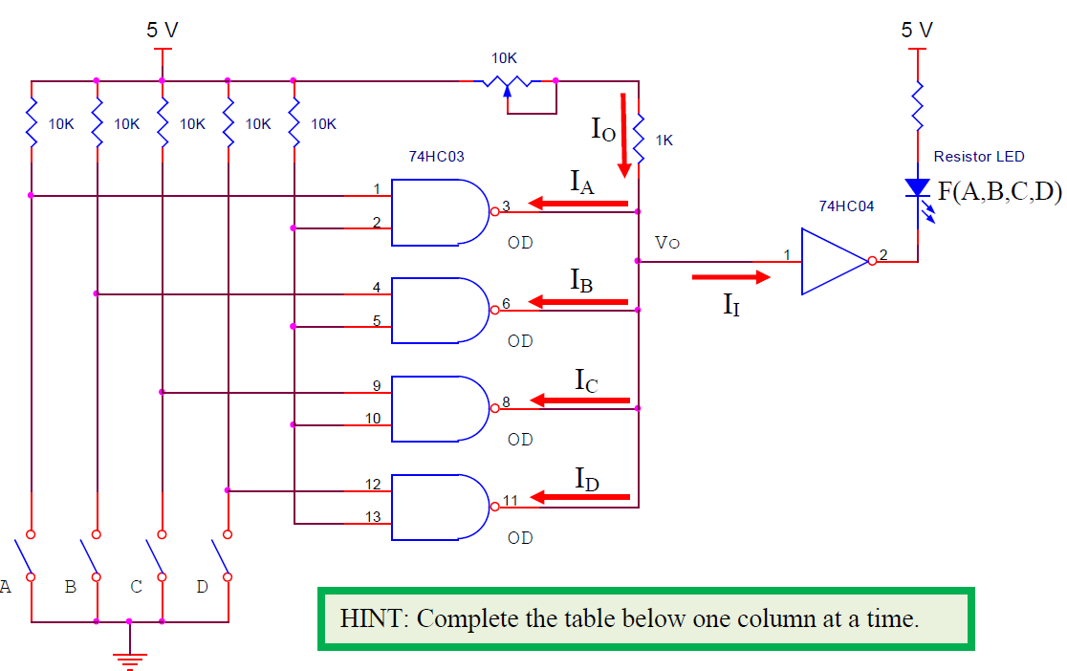
STEP (2): MEASURING STATIC (DC) CHARACTERISTICS BASED ON RMIN
Setting the potentiometer to its minimum resistance setting will create a pull-up resistor for the open-drain gates approximately equal to Rmin.
Complete the voltage/current chart for each case indicated, being careful to measure Vo with respect to ground and currents (I) in series.

Slide 7
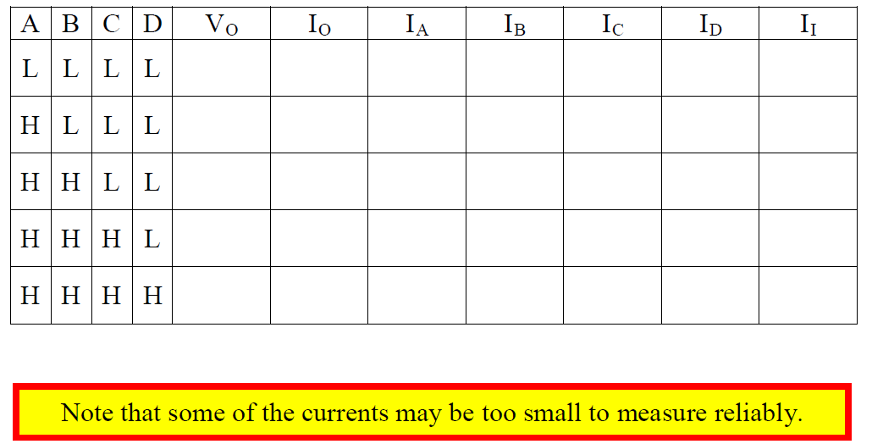
STEP (2): MEASURING STATIC (DC) CHARACTERISTICS BASED ON RMIN

Slide 8
STEP (3): MEASURING STATIC (DC) CHARACTERISTICS BASED ON RMAX
Setting the potentiometer to its maximum resistance setting will create a pull-up resistor for the open-drain gates approximately equal to Rmax.
Complete the voltage/current chart for each case indicated, being careful to measure Vo with respect to ground and currents (I) in series.

Slide 9
STEP (3): MEASURING STATIC (DC) CHARACTERISTICS BASED ON RMAX

Slide 10
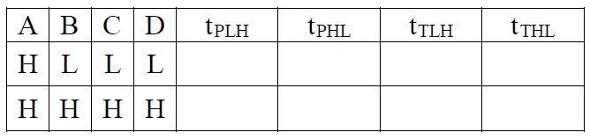
STEP (4): MEASURING DYNAMIC CHARACTERISTICS BASED ON RMIN
Modify the circuit as illustrated below, using the same 12 MHz oscillator and the frequency divider that was used in Experiments 2 and 3 for timing measurements.
Setting the potentiometer to its minimum resistance setting will create a pull-up resistor for the open-drain gates approximately equal to Rmin.
Measure the propagation delay and rise/fall times for each case indicated.
Note that propagation delays should be measured between pin 5 of the 74HC74 and the point labeled Vo; transition times should be measured at node Vo.

Slide 11
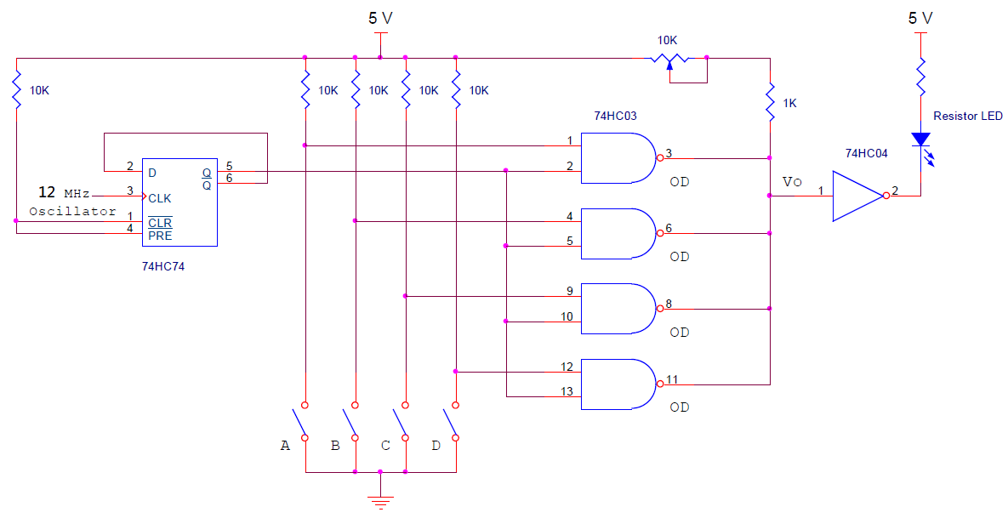
STEP (4): MEASURING DYNAMIC CHARACTERISTICS BASED ON RMIN

Slide 12
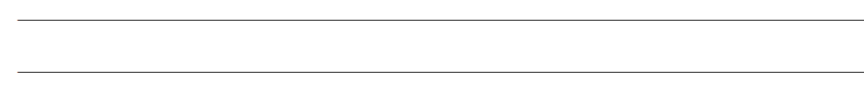
STEP (5): OBSERVING DYNAMIC CHARACTERISTICS BASED ON R > RMIN
Slowly advance the potentiometer from its minimum resistance setting to its maximum setting.
Record your observations concerning the changes in rise/fall times and propagation delays that occur as a function of the pull-up resistor value.

